Slide 1
Drug Analysis
Xueli Zhou
Siyuan Hu
Ruoyu Wang

Slide 2
Agenda
Introduction
Data description
Related Work
Traditional Methods
Deep Learning
Implement
Future Research
Conclusion
Reference

Slide 3
Introduction
In recent years, the average price-tag for getting a new drug to market has risen to about $2.5 billion, with an estimated delivery date of 10-15 years. Our Project aims to find some relation from medical information. So it is meaningful if we can get some information before we start the experiments. And we hope these information could drive some decisions for us.

Slide 4
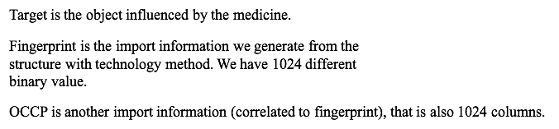
Data Description
The datasets have the target, smile, fingerprint, occp, value and measurement.

Slide 5
Related Work
In 2012, Merck Kaggle challenge on chemical compound activity won by Hinton’s group with deep networks with their DNN model as a error rate of 16.4 %
In 2014, Dahl used another multi-task neural networks for this QSAR applications based on the kaggle algorithms.

Slide 6
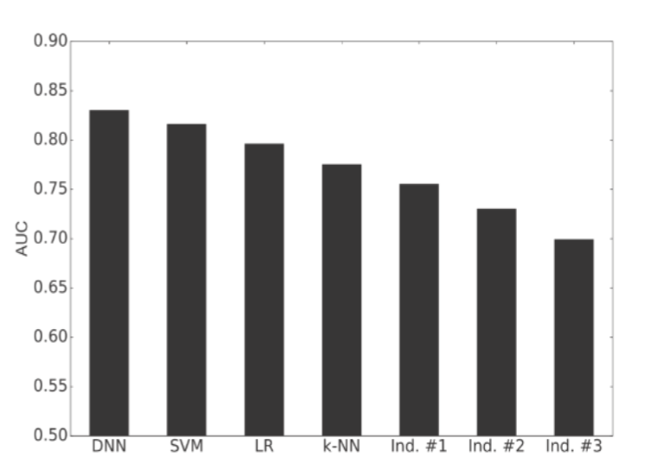
Related Work
In 2014, Hochreiter and co-workers published a peer- review paper. In that essay, the authors used the ChEMBL database including 743,336 compounds, and 5069 targets. They used ECFP4 fingerprints and have a AUC of 0.83.

Slide 7
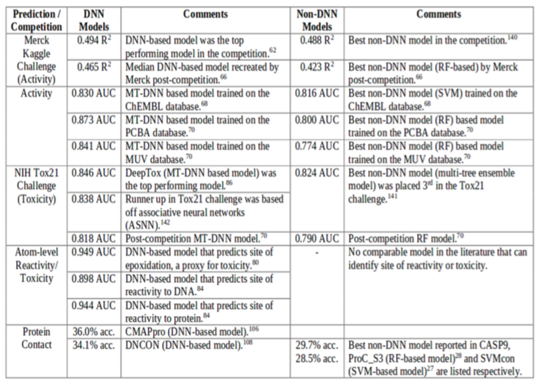
Related Work
In 2015, Merck published a study paper, talking about the comparison between DNNs and RF-based models.

Slide 8
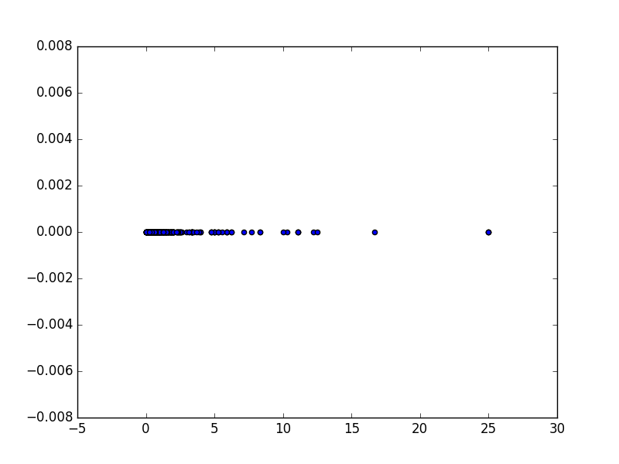
Regression - Single Neuron

Slide 9
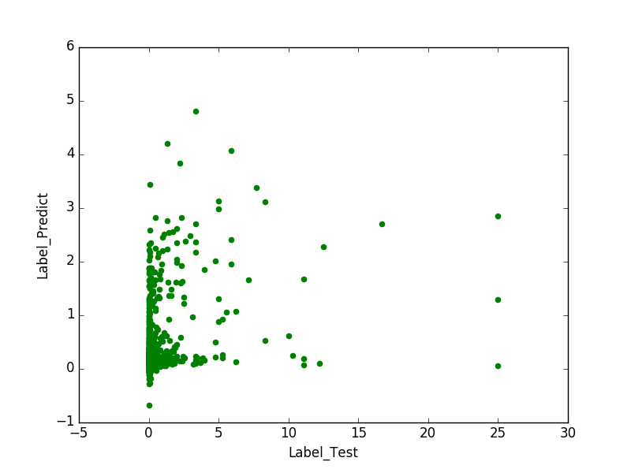
Regression - Basic DNN

Slide 10
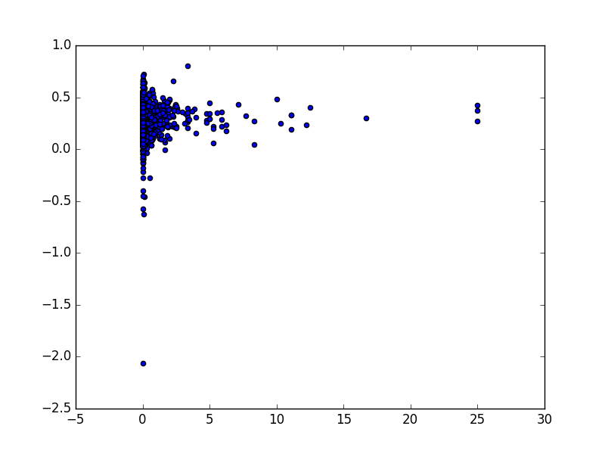
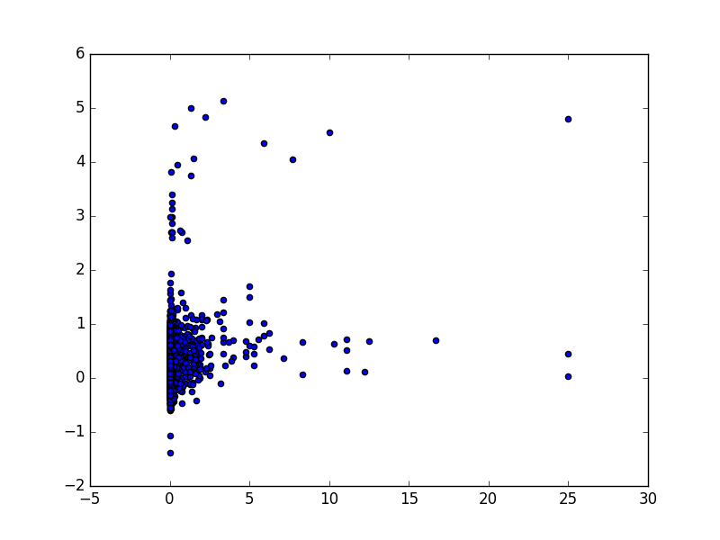
Regression - CNN5-D2

Slide 11
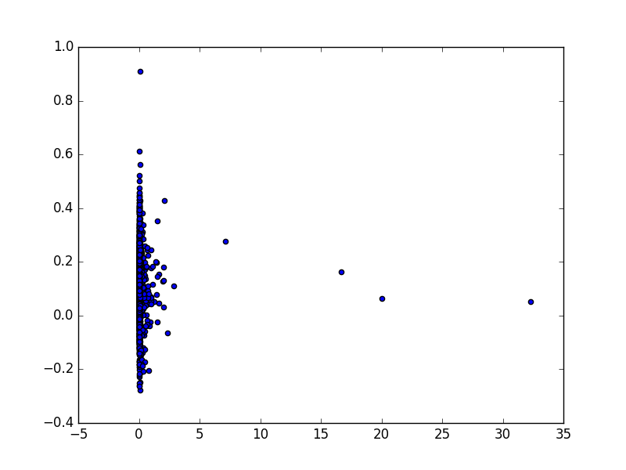
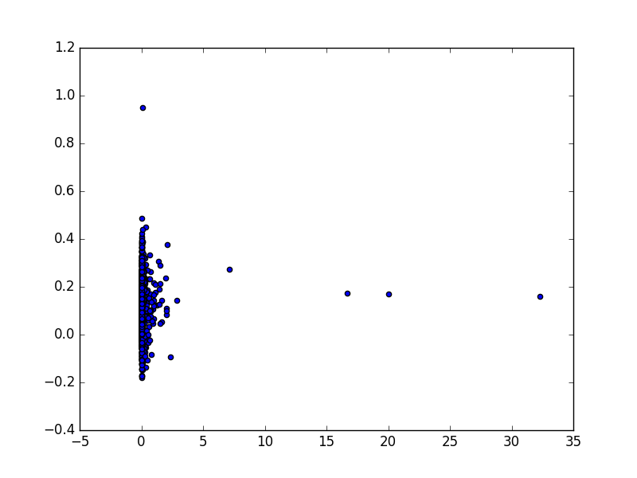
Regression - CNN5-CH

Slide 12
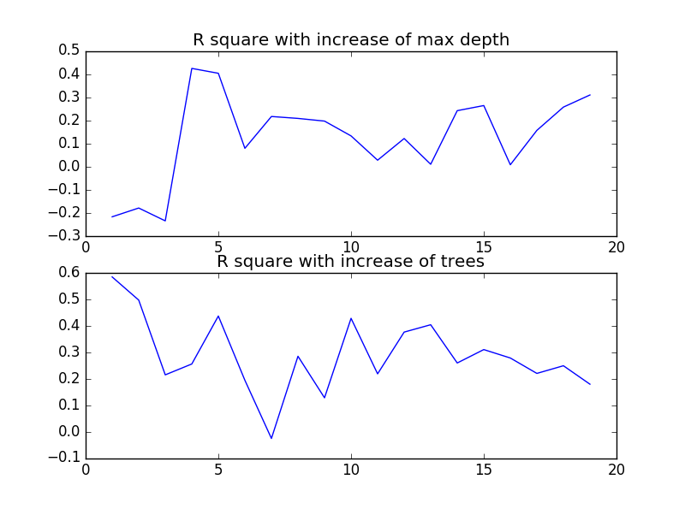
Regression - RF

Slide 13
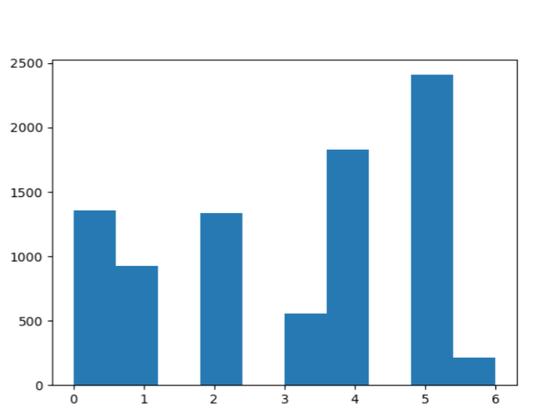
Traditional Methods
X train,X test=X[:int((0.8∗len(X)))],X[int((0.8∗ len(X))) :]
y train, y test = y[: int((0.8 ∗ len(X)))], y[int((0.8 ∗ len(X ))) :]
Evaluation:
F 1 = 2 ∗ (precision ∗ recall)/(precision + recall)
Figure: Target distribution

Slide 14
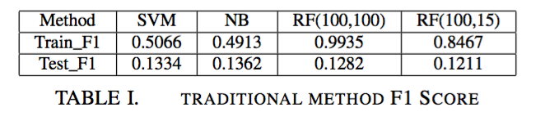
Traditional Methods
We used Support Vector Machine, Random Forest(number of decision tree, depth of decision tree), Naive Bayes to predict the results. And the results are shown below.

Slide 15
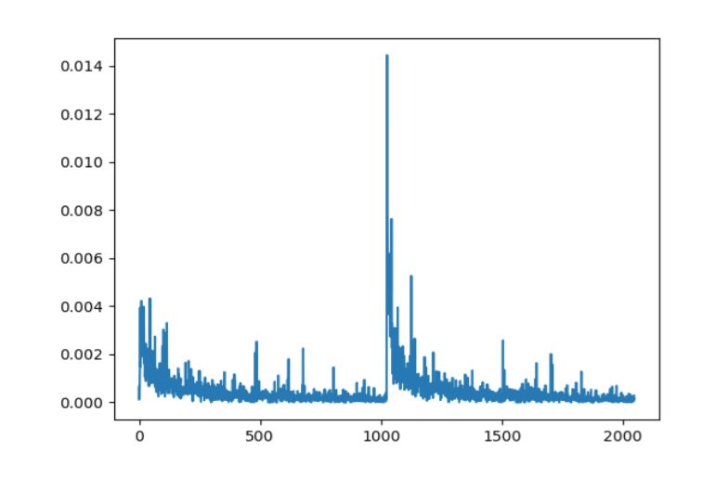
Traditional Methods
Random Forest
Based on the results we choose the first 25 features in fingerprint and the first 25 features in occp.
However, the Accuracy remains the same.
Figure: plot one graph for these 2048 features.

Slide 16
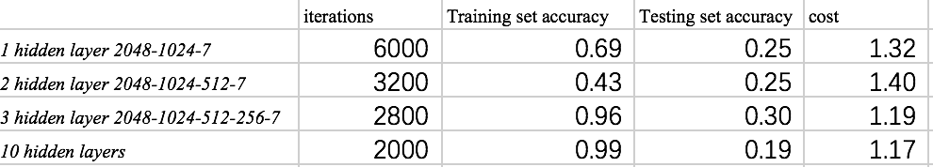
Deep Learning
Neural Network

Slide 17
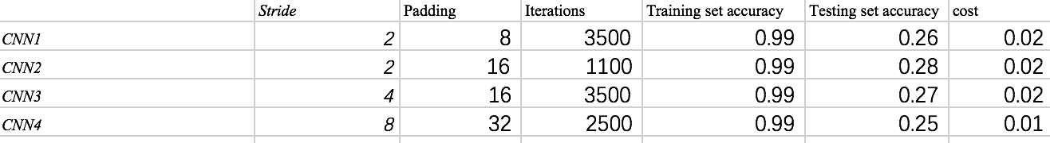
Deep Learning
CNN

Slide 18
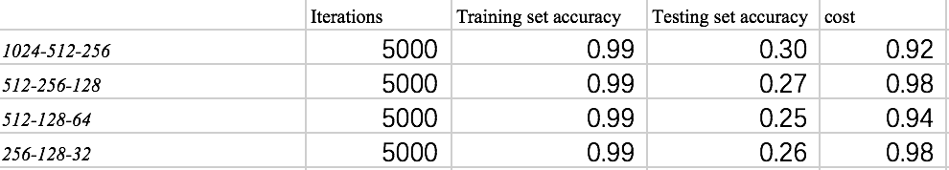
Deep Learning
RNN

Slide 19
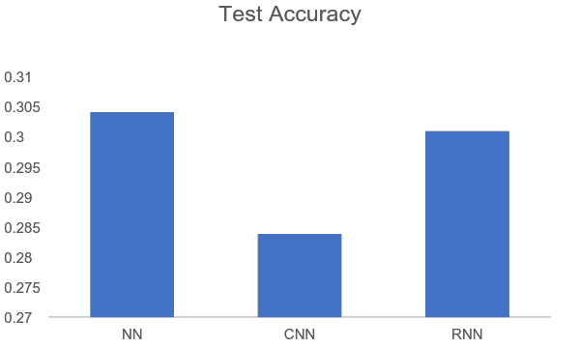
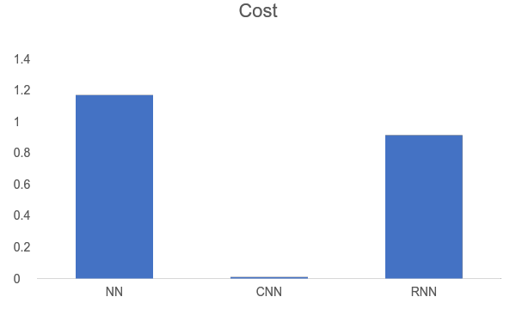
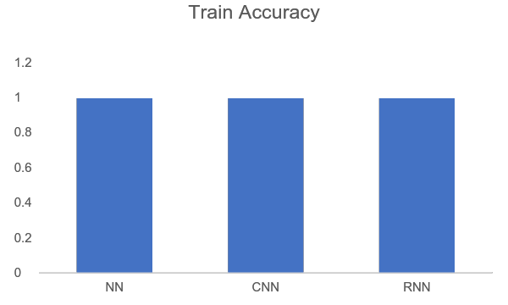
Deep Learning
0.01

Slide 20
Deep Learning --Combine FP and OCCP

Slide 21
Implement
We do not run the neural network more than 10,000 iterations. Since the cost is extremely huge. And the dataset is not big enough for our analysis.
Up to now, the best result is from ... . We can implement our model by using ensemble method. Adding more features into the dataset, or adding more instance into the dataset. And using cross-validation as well.
The most import thing we need to implement is feature engineer. In this project we still not find a good way to extract information from the fingerprints and occp.

Slide 22
Future Research
Use a much larger dataset to analyze this problem.
Find a better method to do feature engineering.
Try to combine various neural network layers to obtain a more complicated neural network structure.

Slide 23
Conclusion
In our project, we experiment several neural works with different parameters. Aims to analyze those information to get a direction of model adjustment. Such as :
1)the number of iterations which the loss function has been convergent.
2) The accuracy of training set
3) The accuracy of testing set
4) The loss function after convergent

Slide 24
Reference
[1] Deep Learning for Computational Chemistry,Garrett B. Goh,Nathan O., Hodas, Abhinav Vishnu
[2] Ajay; Walters, W.p.;Murcko, M.A.J.Med.Chem. 1998,31,3314
[3] Burden, F.R.; Ford, M.G.; Whitley, D.C.; Winkler, D.a.J.Chen=m. inf. Comput. Sci. 2000, 40,1423
[4] Cramatica, P.QSAR Comb. Sci. 2007, 26, 694
[5] Verma, J.; Khedkar, V.M.; Coutinho, E.C.Curr. Top. Med Chem. 2010, 10,95
[6] Kaggle
[7] Dahl, G.E.; Jaitly, N.; Salakhutdinov, R.arXin:1406.1231 2014
[8] Ma,J.;Sheridan, R.P.; Liaw, A.;Dahl, G.E.; Svetnik, V.J. Chem. Inf. Model. 2015m 55m 263

Slide 25
Thank you!
Questions?

